Slide 1
Web Programming 1
Worksheet 4
Improving movie app
With Add a Movie, child components, bootstrap

Slide 2
Week 4 worksheet
Copy week 4 and create new repo and call it week4-movielist
OR branch your repo

Slide 3
Nested/Child Components
Up to now we have only built applications with a single component
However real applications in Angular are made up of multiple components working together
Using multiple components in an application is good, as multiple logical components make it easier for us to:
Architect our applications as they grow in complexity
Re-use common components in multiple places

Slide 4
Our Movie List Application
We want to add functionality to it as well as break up this functionality into child components
We will :
Move our list movie functionality (to a child component)
Have a form that allows us to add movies (also child component)
Improve the look and feel (via Bootstrap styling)
Will do this in our tutorial/lab class

Slide 5
Our top level <app-component> contains all of the other child components
<app-component>
1
<add-movie>
2
3
<list-movies>
<movie-detail>

Slide 6
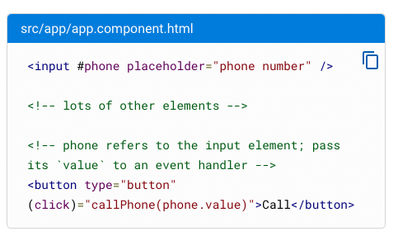
Other terminology we will use
Angular template variables
Help us to share data from one part of our template (.html) to another part of the template

Slide 7
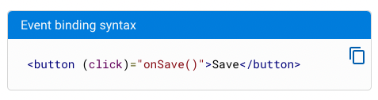
Other terminology we will use
Event binding ()
Based on a mouse/keyboard click, touch, etc – listen and respond to user actions
The event binding listens for the button's click events and calls the component's onSave() method whenever a click occurs.
Typescript – push to array
array.push()

Slide 8

Add bootstrap
From CLI type
npm install bootstrap
In angular.json
node_modules/bootstrap/dist/css/bootstrap.min.css
Within your angular.json file, styles appears in test sections. Add it to just build section – this will be default for use in production, etc
Restart your app with ng serve
Boostrap now available for use in your app

Slide 9
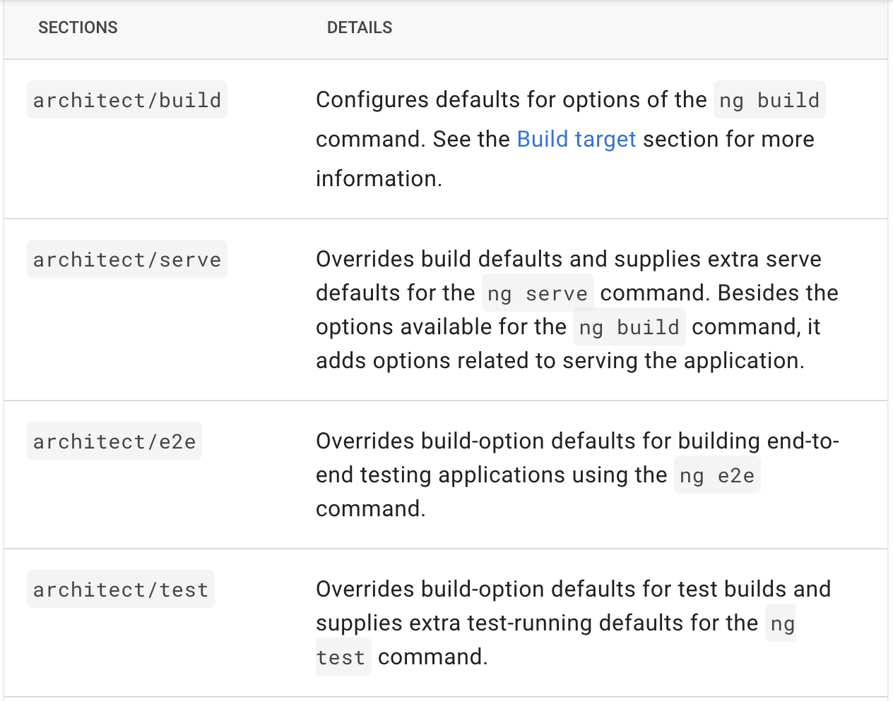
By adding bootstrap to architect/build – this is the default for other builds we might make. If we want to override in other locations such as serve – then we would need to add extra definitions

Slide 10
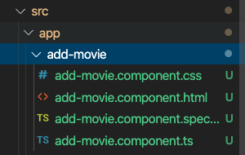
Generating add-movie component
From CLI type
ng generate component add-movie
This generates a folder for the component in our /source/app directory
The component name we use descriptive and short for example
list-movies
movie-detail

Slide 11
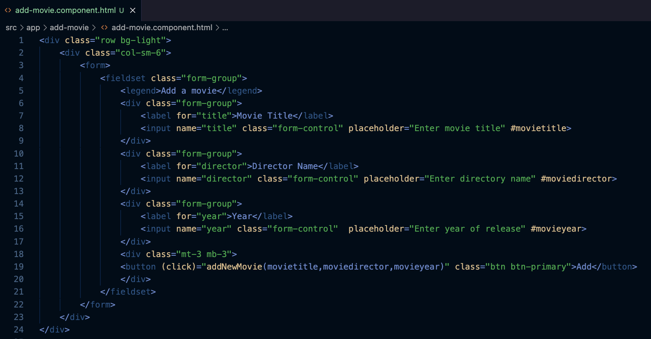
add-movie.component.html
1. Template variable #
2. Event binding ()
3. Call method, passing parameters

Slide 12
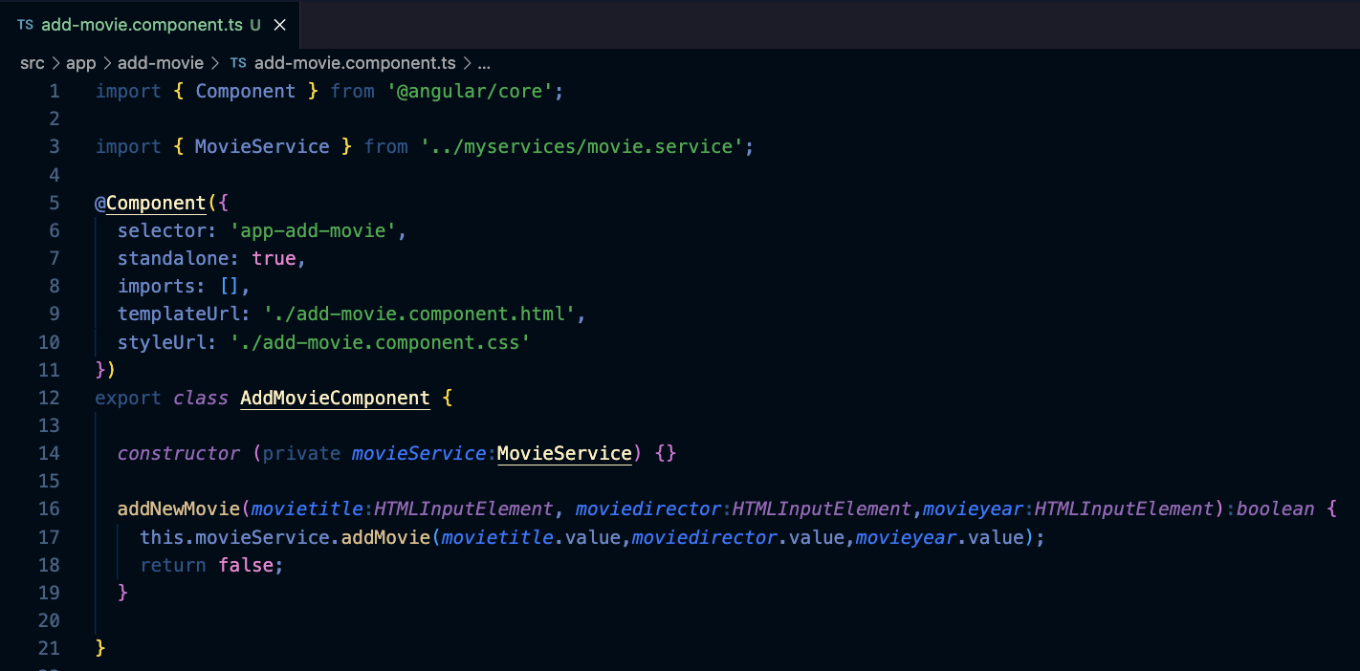
add-movie.component.ts
1. Import service
2. Inject service
3. Method to create service

Slide 13
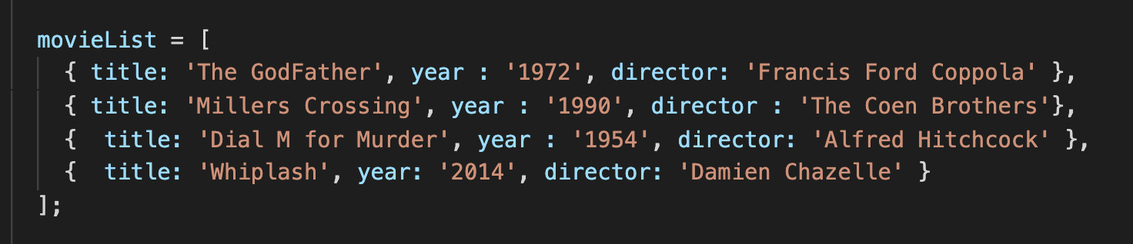
movie.service.ts
Add this code – it pushes the information from our form into our movieList array
Also you can modify the movie list array – remove the id field – we don’t need it…in a DB this is auto generated….

Slide 14
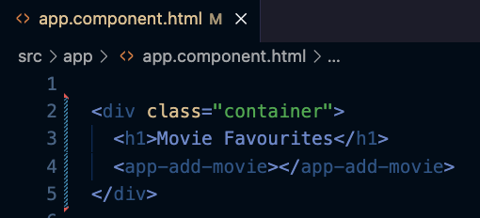
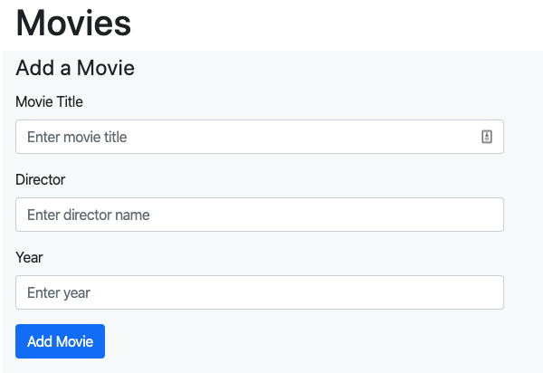
app.component.html
Now we can reference <app-add-movie> in our app.component.html
Our browser at localhost:4200 should now contain this form

Slide 15
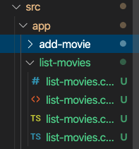
Generating list-movies component
We are going to move list-movies functionality from app.component.html to a new component
From CLI type
ng generate component list-movies
This generates a folder for the component in our /source/app directory

Slide 16
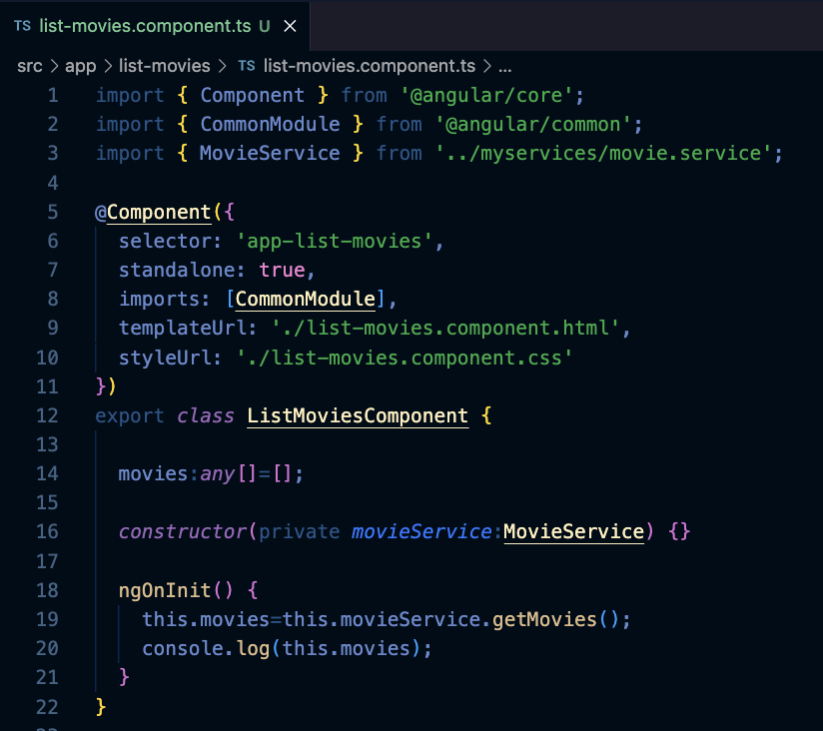
list-movies.component.ts
Import Commonmodule,
Movieservice
2. You will recognize a lot of this code – it previously existed in app.component.ts;
3. Remove from app.component.ts and place here – this component will list our movies now!

Slide 17
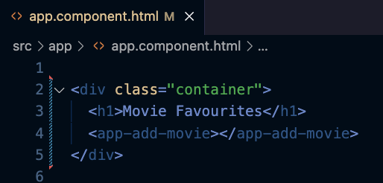
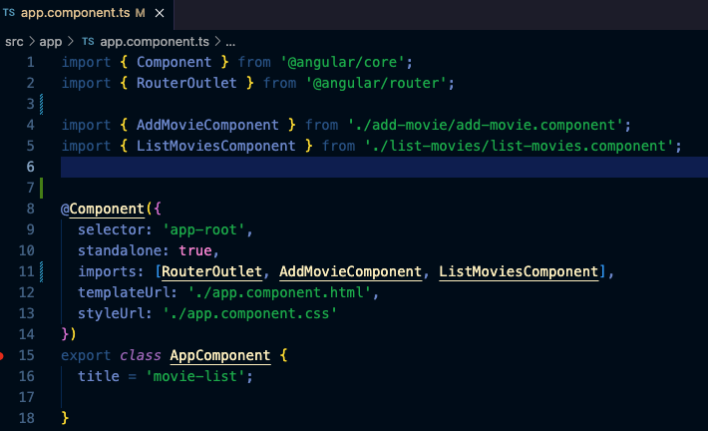
app.component.html
1. As you can see here – the root component has now been emptied of functionality we had previously added. It now exists in our new list-movies.component.ts – which now has responsibility for listing our movies
2. However, we now need to reference our standalone components that are called from app.component.ts

Slide 18
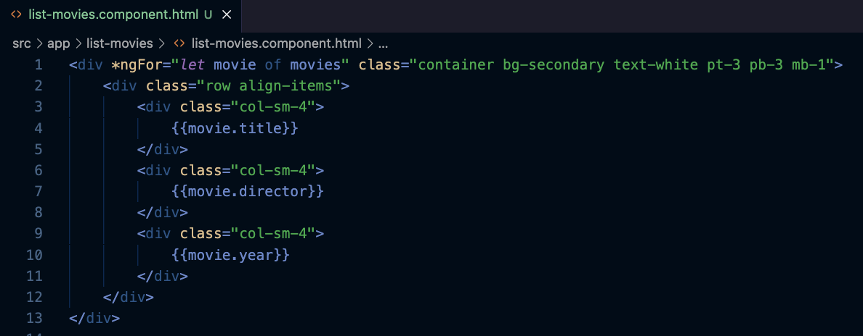
list-movies.component.html
1. You will recognize the *ngFor etc of this code from app.component.html; you can copy that code and refine so it look like this

Slide 19
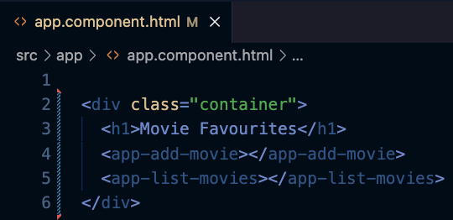
app.component.html
Finally we add our selector for listing movies to app.component.html

Slide 20
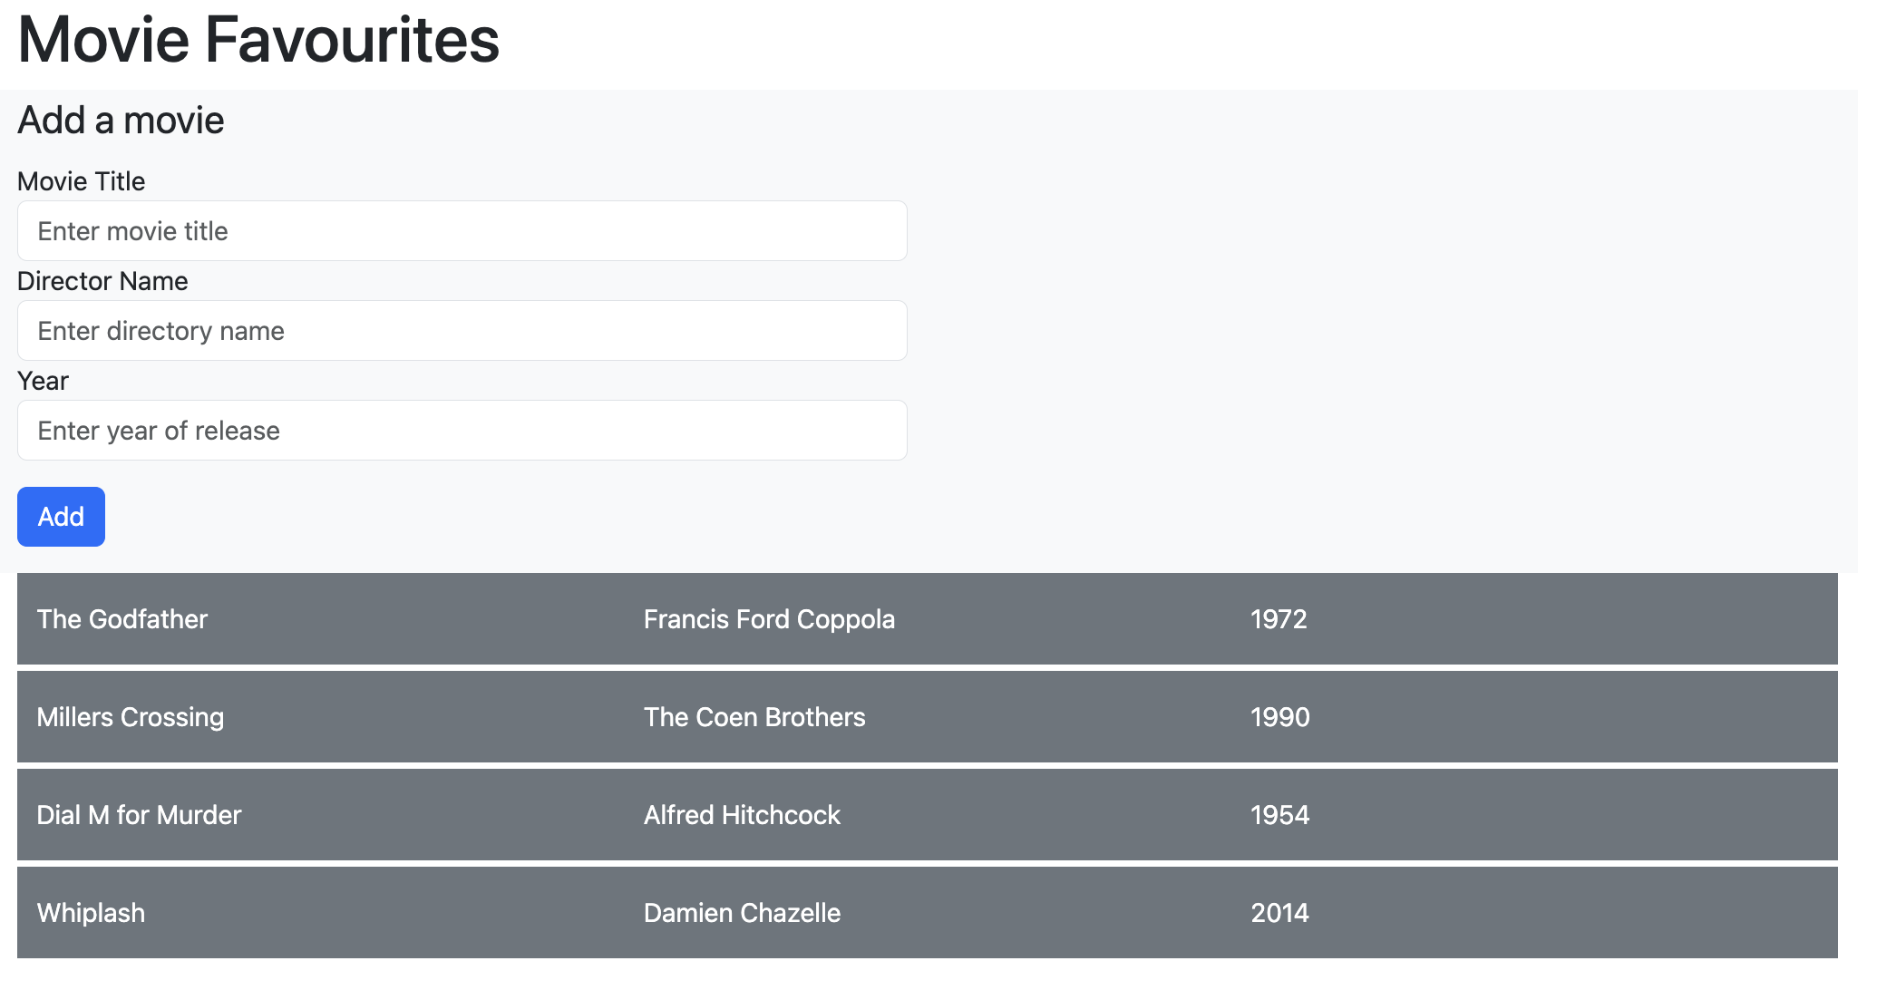
Your app should now look like this

Slide 21
Upload your work (week 4)
Add your name and Student ID
Take a screenshot and add to repo
Download repo from github
Upload to moodle

